Slide 1
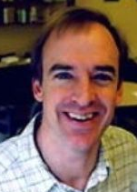
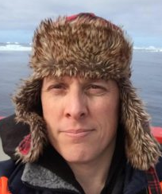
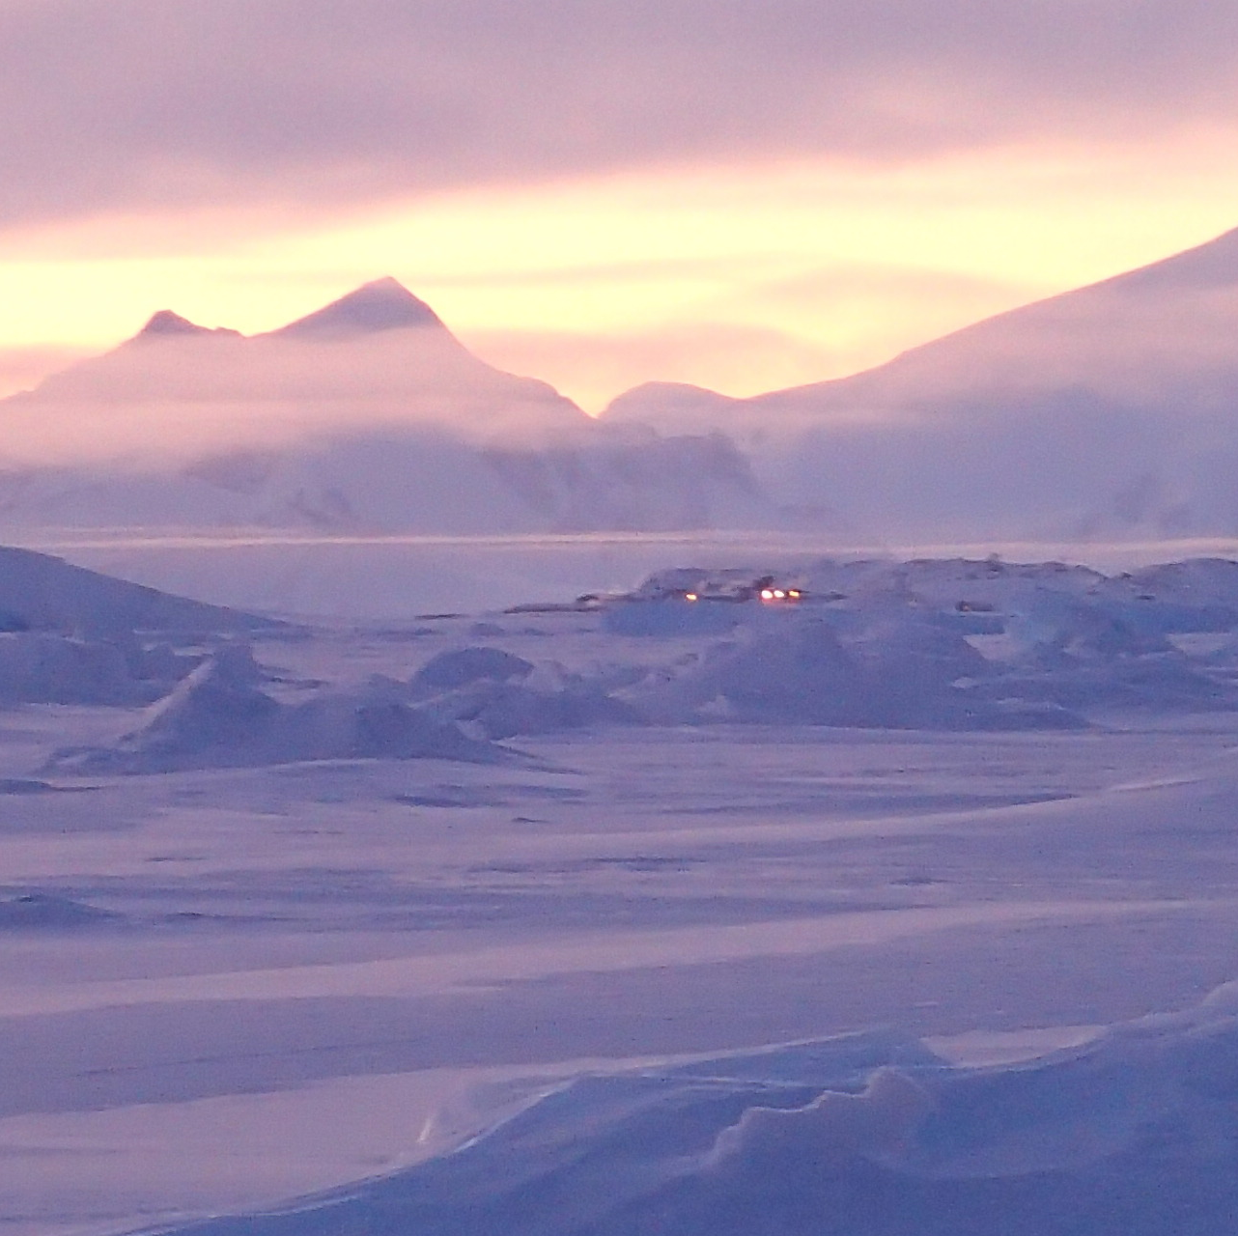

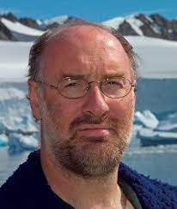
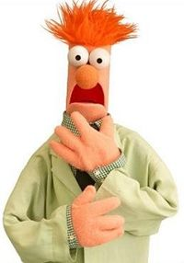
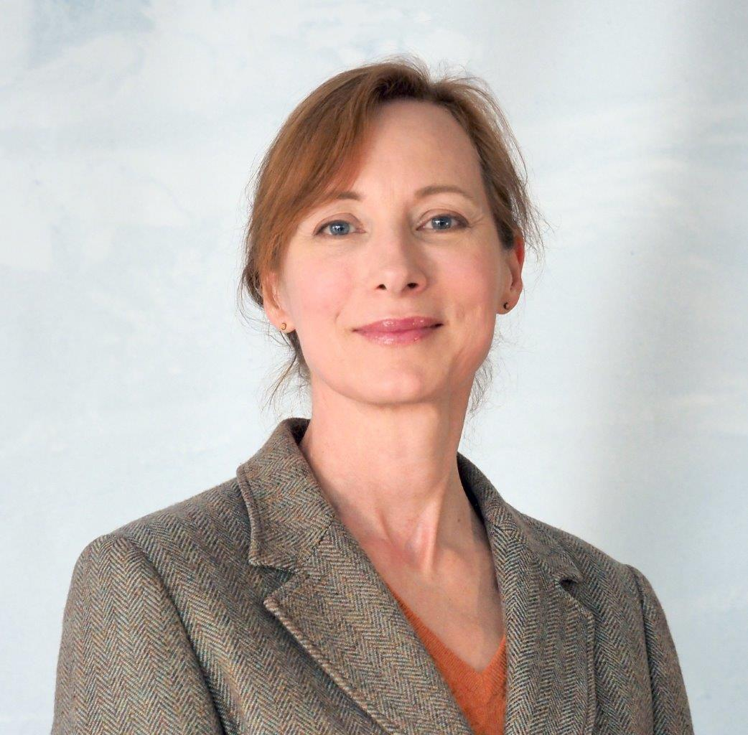
ASK THE EDITORS
Paul Renaud
Akvaplan-niva and Prof II at UNIS (Svalbard), based in Tromsø, Norway
Questions around the scientific publication process?
What happens when you submit your research to a journal?
Huw Griffiths
The British Antarctic Survey, based in Cambridge, UK.
Impact
Review
Visibility
Area of expertise are: ecosystem processes of (Arctic) marine
systems, impacts of climate change and human activities
I am an editor for: Polar Biology, Frontiers in Marine Science
(also special issues in Frontiers in Marine Science,
J Marine Systems, Phil Trans Royal Soc B)
As an editor the things that most frustrate me are: Authors (especially students) insist on trying to link everything to climate change even when the topic and findings are more or less irrelevant to that topic.
An interesting fact about me, I was once a PhD student studying grassland ecology and insect herbivory
Area of expertise are: Antarctic/Polar marine biology, biodiversity, benthos, and biogeography.
I am an editor for Frontiers journals
As an editor the things that most frustrate me are having to find reviewers as it is hard to keep asking the same people
An interesting fact about me, I have two species of sea cucumber named after me (Euthyonidiella huwi & Kolostoneura griffithsi)
Rejected
Process
Ethics
Pete Convey
Senior researcher and Individual Merit Scientist, British Antarctic Survey, Cambridge, UK
Helle V. Goldman
Communications Advisor, Norwegian Polar Institute,
Tromsø, Norway
Area of expertise are: Originally an insect behavioral ecologist. Now a very general ecologist integrating across multiple disciplines. Polar ecology, biodiversity, biogeography, conservation, human impacts
I am editor in Chief for Antarctic Science, Specialty Chief Editor for Frontiers in Ecology and Evolution (Biogeography and Macroecology), Associate Editor for Proceedings of the Royal Society series B, Polar Science, Polish Polar Research and Ukraine Polar journal
As an editor the things that most frustrate me are: Lack of attention to detail, or failure to follow clear requirements of each journal.
An interesting fact about me, I am still a hobby entomologist, something I started at school, and years later I am still finding new moths in my back garden - the latest only this month!
My own area of research is African anthropology/zoology, but the polar journal I edit publishes mostly research in fields like geology, biology, oceanography and glaciology, so I’ve become familiar with these disciplines during my 23 years editing the journal.
I’m the chief editor Polar Research, the Norwegian Polar Institute’s multidisciplinary polar journal, which has been going since 1982
As an editor the things that most frustrate me are: (1) subpar abstracts (a turn-off to invited reviewers, making my task of roping in reviewers harder); (2) the difficulty in getting reviewers (sometimes as many as 20 people are invited before two agree to review a submission); (3) when reviewers don’t turn in reviews, regardless of time extensions granted.
An interesting fact about me, I have a mammalian skull collection, including a number of skulls that I’ve taken from road-kills and cleaned myself.
Thursday 24th Feb
1pm – 3pm (CET)
Online event, Register at
https://docs.google.com/forms/d/e/1FAIpQLSc7PBS1mMGU_MkByzlpAGlA2EqixD34aDSg2Yg0YUDLVLej3g/viewform?usp=sf_link

